Slide 1
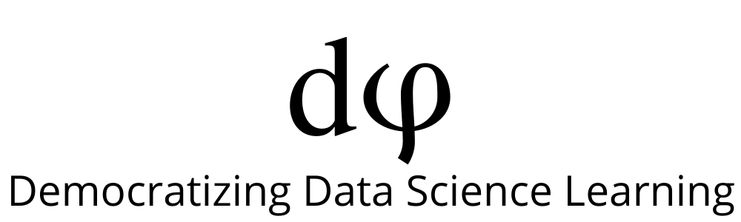
Welcome to Data Science Online Bootcamp
Week#2 - Day 4

Slide 2
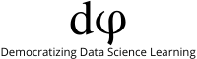
Learning Objectives
The ABC of Machine Learning
Imbalanced Dataset
One-hot encoding
Session Details

Slide 3
The ABC of Machine Learning

Slide 4
What is Machine Learning?
Machine learning provides systems the ability to automatically learn and improve from experience without being explicitly programmed.
It allow computers to discover hidden and useful insights
In nutshell, Machine Learning is a new way of communicating your wishes to a computer.

Slide 5
Machine Learning is used in..
Fraud detection - Eg: Credit card fraud detection. It will help us to detect whether a transaction is fraud or not.
Email spam filtering - Eg: Helps in categorising whether a particular email should go in inbox or spam box.
Recommendation engines - Eg: E-commerce platforms like Amazon can recommend you a similar product based on your previously browsed list of products
and many more!!!

Slide 6
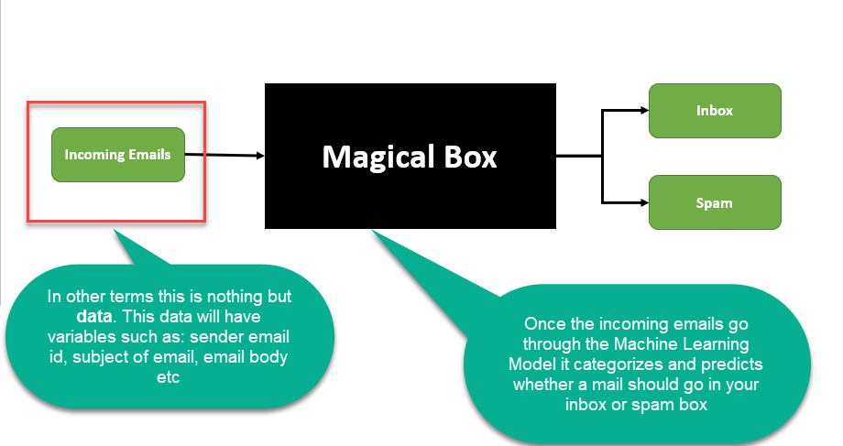
What is a Machine Learning (ML) model?
For now, let’s consider it is a Magical box that help us to predict what we want. In the below case we want to predict whether an incoming email should land in our inbox or spam box. We will discuss more about ML models soon.

Slide 7
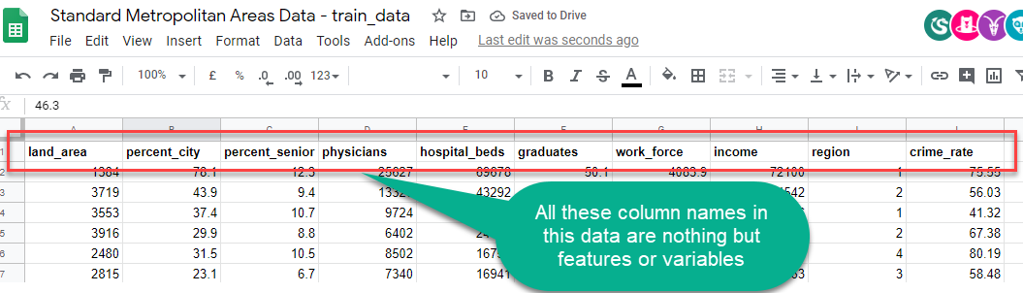
Variables/features
Features or Variables: These are the the most common terms that we would come across from now on.
Features and Variables both are the same in a dataset, they are often interchangeably used. So there is no need to worry about it!

Slide 8
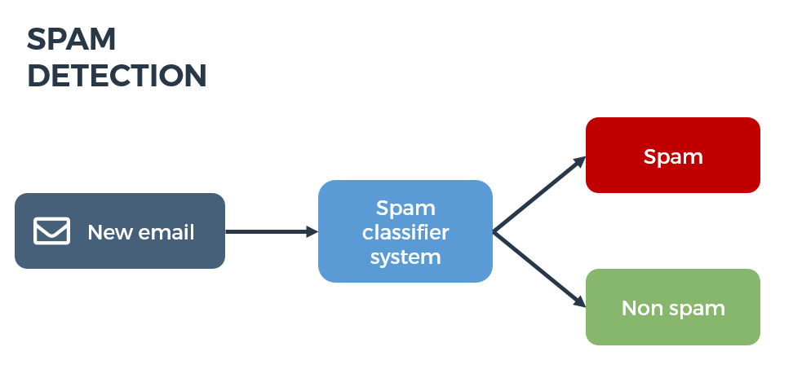
Target/Label Variable
The target variable or label of a dataset is the feature of a dataset about which you want to gain a deeper understanding.
It is the variable that is, or should be the output.
In the example of detecting spam emails, the label will be the category the email belongs to, i.e it will be either ‘spam’ or ‘not spam’.

Slide 9
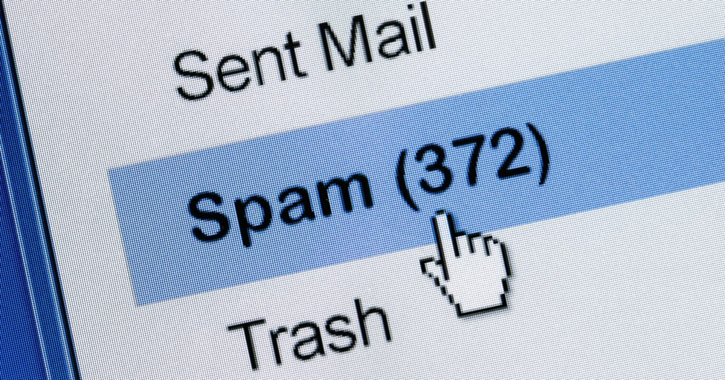
Predictor/Input Variables
One or more variables that are used to determine (or predict) the 'Target Variable' are known as Input Variables. They are sometimes called Predictor Variable as well.
In the spam detector example, the features could include the following:
words in the email text
sender's address
time of day the email was sent
email contains the phrase "congrats you won $1 billion - share your bank details."

Slide 10
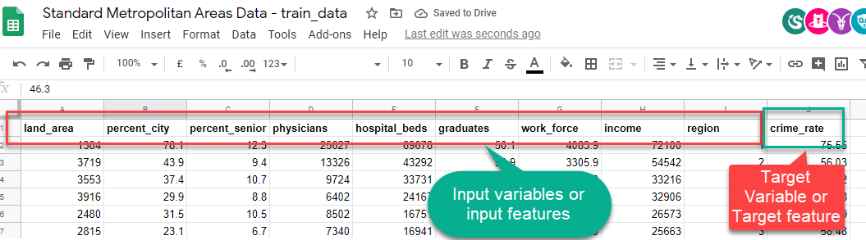
Target and Input variables
Remember the Standard Metropolitan Areas Data used in previous slides? In that dataset we might be curious to predict “crime_rate” in future, so that becomes our target variable and rest of the variables become input variables for building a machine learning model.

Slide 11
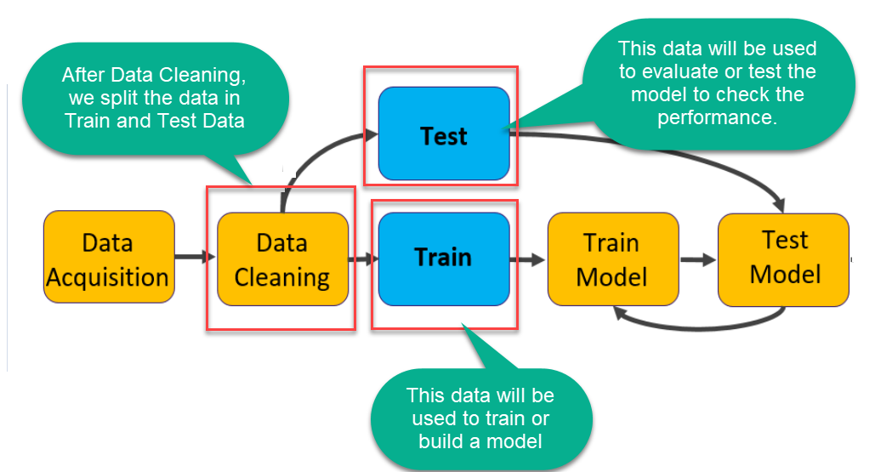
Train and Test Set

Slide 12
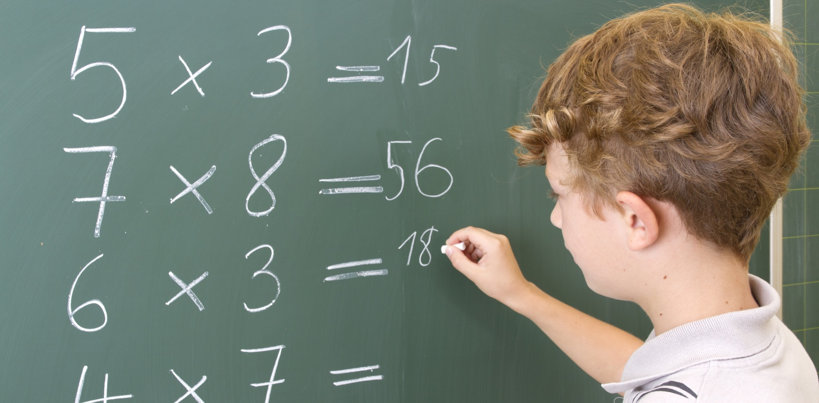
Train and Test Set
To use an analogy, let’s say you teach a child to multiply by letting the kid train on the small multiplication table, i.e. everything from 1*1 to 9*9.
Next, you test whether the kid is able to perform the same multiplications. The result is a success. The kid gets it right almost every time.
What’s the problem here?
You don’t know if the kid understands multiplication at all, or has simply memorized the table!
So what you would do instead is test the kid on multiplications like 11*12, that are outside of the table.

Slide 13
Train and Test Dataset
So what you would do instead is test the kid on multiplications like 11*12, that are outside of the table.
This is exactly why we need to test machine learning models on unseen data or test data. Otherwise, we have no way of knowing whether the algorithm has learned a generalizable pattern or has simply memorized the training data.
TRAINING DATA: The observations in the training set form the experience that the algorithm uses to learn.
TEST DATA: The test set is a set of observations used to evaluate the performance of the model using some performance metric. It is important that no observations from the training set are included in the test set. If the test set does contain examples from the training set, it will be difficult to assess whether the algorithm has learned to generalize from the training set or has simply memorized it.

Slide 14
Train Test Split
Consider an Example where our Original Dataset has 1000 rows.
When we start building our ML model we will split our datatset into two parts (70% train data and 30% test data).
We will train our model on 70% of data i.e 700 rows and then test our model performance on 30% of data i.e 300 rows. As discussed above while testing our model we will not provide the outcome to our model for the test data although we know the outcome and instead let our model give us the outcome for those 300 rows.
Later we will compare the outcome of our model to the original outcome of our test data to get the accuracy of our model predictions.
For splitting our data to training and testing set we use train_test_split method of scikit-learn library.

Slide 15
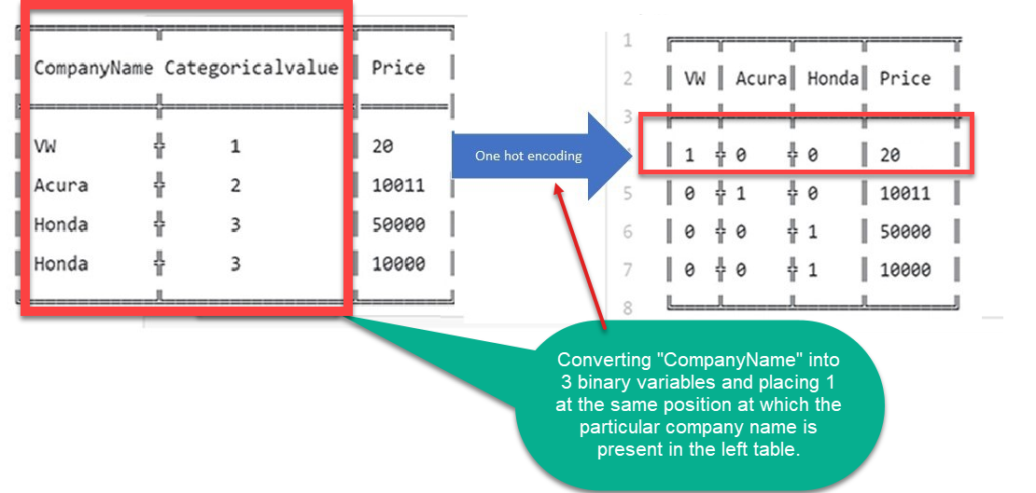
One Hot Encoding
Binary is nothing but assign 0 or 1

Slide 16
One Hot Encoding
One hot encoding is a process by which categorical variables (do you remember what categorical variables mean from the stats module?) are converted into a form that could be provided to ML algorithms to do a better job in prediction.
Let’s consider the dataset in the previous slide
The Categoricalvalue is just a number assigned to each car company name.
The problem with this is that it assumes higher the categorical value, better the category. But that’s definitely not the case, right?
This is why we use one hot encoder to perform “binarization”(representation in 0 and 1) of the category and include it as a feature to train the model.

Slide 17
One Hot Encoding
Now what do the 0s and 1s actually represent?
Look closely at the table on the right in previous slide. In the company name variable example, there are 3 categories (3 car companies) and therefore 3 binary variables are needed ( VW, Acura, Honda).
A “1” value is placed in the binary variable at the same position at which the particular company name is present in the left table. The rest are kept “0” in that variable’s column. The remaining 2 variable columns are filled in similar manner.
In short, all the elements of the vector are 0 except one, which has 1 as its value.
MUST READ: The following resource justifies the necessity of one hot encoding our data:
https://machinelearningmastery.com/why-one-hot-encode-data-in-machine-learning/

Slide 18
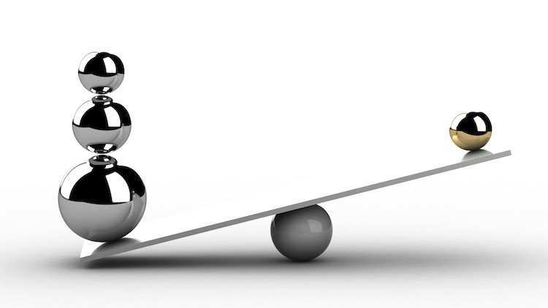
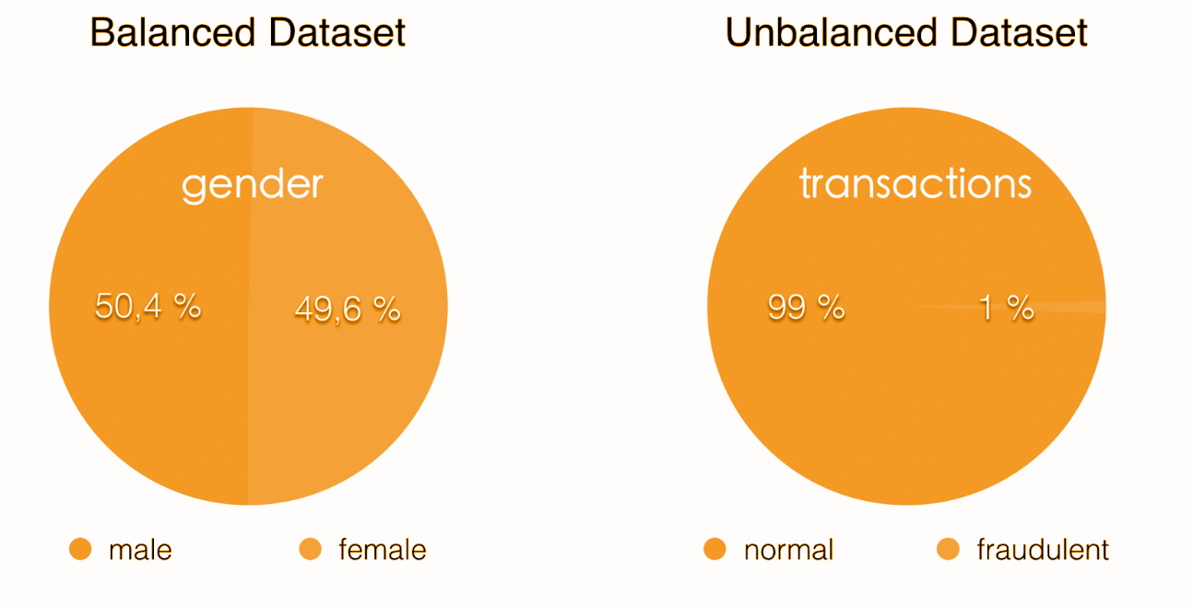
Imbalanced Dataset

Slide 19
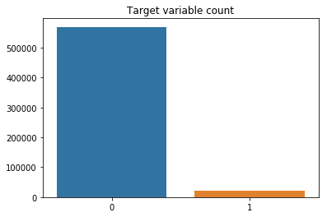
Imbalanced Dataset
For example, suppose you have a credit card transaction data and you are supposed to predict fraudulent transactions. You'll likely have 10,000 authentic transactions for every 1 fraudulent transaction, that's quite an imbalance!
In machine learning terms: Often you'll have a large amount of data/observations for one class (referred to as the majority class), and much fewer observations for one or more other classes (referred to as the minority classes).

Slide 20
Imbalanced Dataset
The problem is that machine learning models trained on unbalanced datasets often have poor results when they have to generalize (predict a class or classify unseen observations). Despite the algorithm you choose, some models will be more susceptible to unbalanced data than others. Ultimately, this means you will not end up with a good model, and the reasons include:
The algorithm receives significantly more examples from one class, prompting it to be biased towards that particular class.
It does not learn what makes the other class “different” and fails to understand the underlying patterns that allow us to distinguish classes.

Slide 21
Imbalanced Dataset
Can you think of any other example where there is class imbalance?

Slide 22
Data Pre-Processing
Instructors’ recommended article: https://towardsdatascience.com/data-preprocessing-concepts-fa946d11c825 P.S: Try opening in incognito if it is asking for a premium subscription upgrade

Slide 23
Download Dataset
Download IEEE Fraud Dataset​: https://bit.ly/Dataset_FraudDetection
!!! - it is a huge dataset so opening it in excel might be difficult, so please open it via python environment - (Colab or Jupyter notebook)
Read about this dataset here: https://www.kaggle.com/c/ieee-fraud-detection/data

Slide 24
About the Dataset
IEEE Fraud Dataset
The data is broken into two files identity and transaction, which are joined by TransactionID​
Transaction Table *
TransactionDT: timedelta from a given reference datetime (not an actual timestamp)
TransactionAMT: transaction payment amount in USD
ProductCD: product code, the product for each transaction
card1 - card6: payment card information, such as card type, card category, issue bank, country, etc.
addr: address of the customer
dist: distance
P_ and (R__) emaildomain: purchaser and recipient email domain

Slide 25
About the Dataset
M1-M9: match, such as names on card and address, etc.
Categorical Features:
ProductCD
card1 - card6
addr1, addr2
Pemaildomain Remaildomain
M1 - M9 (bank sensitive data)
Note: Some of the feature/variable description is not given as

Slide 26
About the Dataset
Identity Table *
Variables in this table are identity information – network connection information (IP, ISP, Proxy, etc) and digital signature (UA/browser/os/version, etc) associated with transactions.
They're collected by Vesta’s fraud protection system and digital security partners.
(The field names are masked and pairwise dictionary will not be provided for privacy protection and contract agreement)
Categorical Features:
DeviceType
DeviceInfo
id12 - id38

Slide 27
Notebook Link
https://github.com/dphi-official/Imbalanced_classes
!! The dataset takes a lot of time to upload on colab. You might prefer using Jupyter Notebook for this one.

Slide 28
Session Details
Tutor: Bharat Ram Ammu (Head of Data Science, Complidata)
Topic: Data Pre-processing and Handling missing values and dealing with class imbalance
Date & time: 6th June, at 8:30 pm IST (please locate your time in your timezone here).
Youtube live link: https://youtu.be/vksQx1JNo8Y

Slide 29
That’s it for the day. Thank you!
Feel free to post any queries in the #help channel on Slack

